Slide 1
Dr. SNS RAJALAKSHMI COLLEGE OF ARTS & SCIENCE (Autonomous)
Coimbatore -641049
Accredited by NAAC(Cycle–III) with ‘A+’ Grade
(Recognized by UGC, Approved by AICTE, New Delhi and
Affiliated to Bharathiar University, Coimbatore)
DEPARTMENT OF COMMERCE WITH INFORMATION TECHNOLOGY
COURSE NAME : Business Information Technology
I YEAR /II SEMESTER
Business Information Technology
Unit 3-Topic 1 : E Commerce

Slide 2
E COMMERCE
Ecommerce" or "electronic commerce" is the trading of goods and services on the internet.
E COMMERCE Security
Confidentiality
Integrity
Availability
Authenticity
Non-Repudiability
Encryption
Auditability

Slide 3
Security Protocols in Internet
Secure Socket Layer (SSL)
It is the most commonly used protocol and is widely used across the industry. It meets following security requirements −
• Authentication
• Encryption
• Integrity
• Non-reputability
Secret Key Cryptography
secret-key cryptography, both communicating parties, Alice and Bob, use the same key to encrypt and decrypt the messages. Before any encrypted data can be sent over the network, both Alice and Bob must have the key and must agree on the cryptographic algorithm that they will use for encryption and decryption

Slide 4
Firewall
A Firewall is a network security device that monitors and filters incoming and outgoing network traffic based on an organization's previously established security policies. At its most basic, a firewall is essentially the barrier that sits between a private internal network and the public Internet.
Information Systems
Information system refers to various information technology systems like computers, software, database, communication systems, the internet, devices, and others used by an organization to collect, transfer, organize, and store data.
03/04/2023

Slide 5
Types Of Information Systems
Knowledge Work System
Management Information System
Decision Support System
Office Automation System
Transaction Processing System
Executive Support System

Slide 6
Functions of operating system
Enterprise resource planning (ERP)
Applying information systems to enterprise resource planning helps automate business administration and planning functions.
Supply chain management (SCM)
Information systems provide a common forum to connect with different parties in supply chain management. Moreover, it makes communication between parties easy and resourceful.
Customer relationship management (CRM)
Many information systems help in realizing customer requirements. Furthermore, other information applications help companies interact with their audience easily and hassle-free.

Slide 7
Objectives of MIS
Capturing Data − Capturing contextual data, or operational information that will contribute in decision making from various internal and external sources of organization.
• Processing Data − The captured data is processed into information needed for planning, organizing, coordinating, directing and controlling functionalities at strategic, tactical and operational level. Processing data means
• Information Storage − Information or processed data need to be stored for future use.
• Information Retrieval − The system should be able to retrieve this information from the storage as and when required by various users.
• Information Propagation − Information or the finished product of the MIS should be circulated to its users periodically using the organizational network.

Slide 8
Characteristics of MIS
• It should be based on a long-term planning.
• It should provide a holistic view of the dynamics and the structure of the organization.
• It should work as a complete and comprehensive system covering all interconnecting sub-systems within the organization.
• It should be planned in a top-down way, as the decision makers or the management should actively take part and provide clear direction at the development stage of the MIS.
• It should be based on need of strategic, operational and tactical information of managers of an organization.
• It should also take care of exceptional situations by reporting such situations.

Slide 9
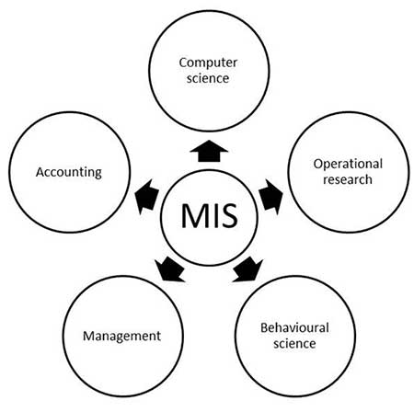
Nature and Scope of MIS

Slide 10
Decision support systems
(DSS) are interactive software-based systems intended to help managers in decision-making by accessing large volumes of information generated from various related information systems involved in organizational business processes, such as office automation system, transaction processing system, etc.
Characteristics of a DSS
• Support for interdependent or sequential decisions.
• Support for intelligence, design, choice, and implementation.
• Support for variety of decision processes and styles.
• DSSs are adaptive over time.

Slide 11
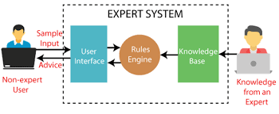
Benefits of DSS
• Improves efficiency and speed of decision-making activities.
• Increases the control, competitiveness and capability of futuristic decision-making of the organization.
• Facilitates interpersonal communication.
• Encourages learning or training.
Expert system

Slide 12
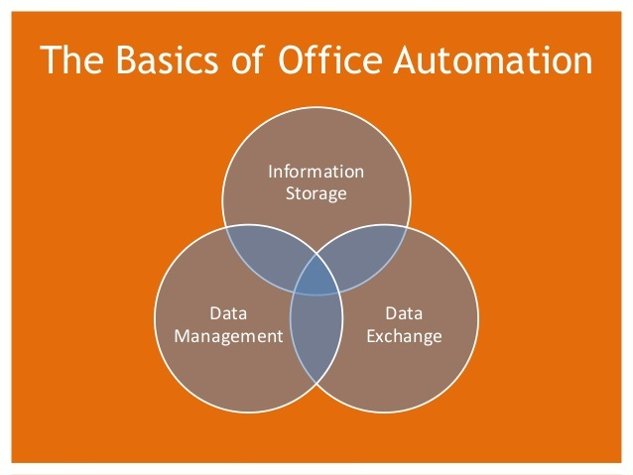
Office Automation Systems
Office automation is the process of watching data flow around on its own without any human intervention, inaccuracies, and errors. It is the process of using an automation tool to create, collect, store, analyse, and share confidential office data that is required to accomplish basic day-to-day routine tasks and processes effectively.

Slide 13
Office automation features
It eliminates the manual effort to complete basic chores.
Avoiding mistakes by computers or devices.
Decreasing the time taken to process an object.
Provides key insights into the process efficiency metrics.
Gaining greater access to the method and finding possible bottlenecks.
Controlling the company by making sound decisions based on results.
Enhancement in business activities with sound improvement.
Data organization, storage and its management.

Slide 14
Office Automation Systems
Electronic Data Storage
Electronic Communication
Computer-Based Staffing
Business Software

Slide 15
Computer Related Jobs
Programmer
A person who is qualified enough to write a creative code for the computer program is known as Programmer.
System Analyst
Database Administrator
Network Administrator
Web Designers
Information Security Analysts

